Slide 1
Instructor Materials Chapter 12: Security
IT Essentials v6.0
Notes:
Cisco Networking Academy Program
IT Essentials
Chapter 12: Security

Slide 2
Instructor Materials - Chapter 12 Planning Guide
This PowerPoint is divided in two parts:
Instructor Planning Guide
Information to help you become familiar with the chapter
Teaching aids
Instructor Class Presentation
Optional slides that you can use in the classroom
Begins on slide #11
Note: Remove the Planning Guide from this presentation before sharing with anyone.
Notes:
2

Slide 3
ITE 6.0 Planning Guide
Chapter 12: Security
Notes:
ITE 6.0 Planning Guide
Chapter 12: Security

Slide 4
Chapter 12: Activities
What activities are associated with this chapter?
Page Number | Activity Type | Activity Name
12.1.1.2 | Interactive Activity (IA) | Identify Malware Types
12.1.1.7 | IA | Identify TCP/IP Attacks
12.2.1.8 | Lab | Configuring Windows Local Security Policy
12.2.3.9 | IA | Identify Data Protection Terminology
12.2.5.8 | PT | Configure Wireless Security
12.2.6.3 | IA | Identify the Physical Security Device
The password used in the Packet Tracer activities in this chapter is: PT_ITE!
Notes:
4

Slide 5
Chapter 12: Activities (Cont.)
What activities are associated with this chapter?
Page Number | Activity Type | Activity Name
12.3.1.3 | Lab | Data Backup and Recovery in Windows 8
12.3.1.3 | Lab | Data Backup and Recovery in Windows 7 and Vista
12.3.1.5 | Lab | Configure the Firewall in Windows 8
12.3.1.5 | Lab | Configure the Firewall in Windows 7 and Vista
12.3.1.9 | Lab | Configure Users and Groups in Windows
12.4.2.2 | Lab | Document Customer Information in a Work Order
The password used in the Packet Tracer activities in this chapter is: PT_ITE!
Notes:
5

Slide 6
Chapter 12: Assessment
Students should complete Chapter 12, “Assessment” after completing Chapter 12.
Quizzes, labs, Packet Tracers and other activities can be used to informally assess student progress.
Notes:
6

Slide 7
Chapter 12: Best Practices
Prior to teaching Chapter 12, the instructor should complete Chapter 12, “Assessment.”
The goal of this chapter is for the student to be able to implement basic host, data, and network security.
Make sure students can describe the variety of common security threats including malware, phishing, spam, zero-day attacks, and social engineering.
Students should be able to explain the importance of a security policy
Make sure students can describe techniques to secure hosts, data, and networks.
Students should be able to implement security in Windows and a wireless router.
Students should be able to explain how to maintain secure hosts, data, and networks.
Students should be able to troubleshoot basic security issues.
Notes:
7

Slide 8
Chapter 12: Additional Help
For additional help with teaching strategies, including lesson plans, analogies for difficult concepts, and discussion topics, visit the ITE Community at community.netacad.net.
If you have lesson plans or resources that you would like to share, upload them to the ITE Community in order to help other instructors.
Notes:
8

Slide 9
Chapter 12: Topics in chapter that are not found in the CompTIA A+ 220-901 Certification
This slide lists content included in this chapter that is NOT listed in the CompTIA A+ 220-901 blueprint. Instructors could skip these sections; however, they should provide additional information and fundamental concepts to assist the student with the topic.
All content in Chapter 12 is aligned to the certification.
Notes:
9

Slide 10
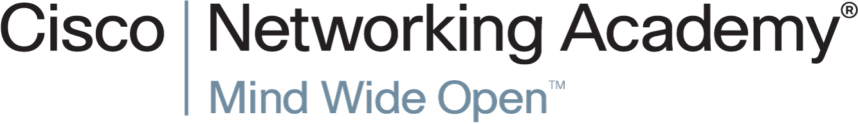

Slide 11
Chapter 12: Security
IT Essentials v6.0
Notes:
Cisco Networking Academy Program
IT Essentials
Chapter 12: Security

Slide 12
Chapter 12 - Sections & Objectives
12.1 Security Threats
Explain security threats.
12.2 Security Procedures
Configure IT security.
12.3 Common Preventive Maintenance Techniques for Security
Manage IT security on an ongoing basis.
12.4 Basic Troubleshooting Process for Security
Explain how to troubleshoot basic security problems.
12.5 Chapter Summary
Notes:
12

Slide 13
12.1 Security Threats
Notes:
Cisco Networking Academy Program
IT Essentials
Chapter 12: Security

Slide 14
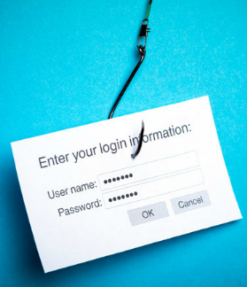
Security Threats Types of Security Threats
Malicious software (malware) is:
Usually installed without user knowledge
Capable of modifying the user’s browser
Often collects user information
Viruses, Trojans, and worms are examples of malware.
Phishing is designed to trick a user into providing personal or financial information.
Spam is unsolicited email that is often used for phishing attacks, or to deliver malware.
Web browser tools, such as Java and Adobe Flash, can make computers more vulnerable to attacks.
Zero-Day attacks attempt to exploit software vulnerabilities that are unknown or undisclosed by the software vendor.
Notes:
12.1 - Security Threats
12.1.1 - Types of Security Threats

Slide 15
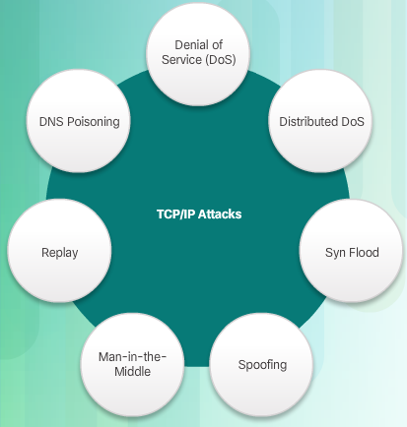
Security Threats Types of Security Threats
TCP/IP is vulnerable to a variety of attacks including:
Denial of Service (DoS) attacks send an abnormally large amount of traffic. The goal is to completely overwhelm the device that is receiving this traffic so that it cannot respond to legitimate users.
Distribute DoS (DDoS) attacks use botnets located in different geographical places, making it difficult to trace the source.
A SYN flood attack randomly opens TCP ports at the source of the attack and ties up the network equipment or computer with a large amount of false SYN requests.
A spoofing attack is when a computer uses a forged IP or MAC address to impersonate a computer that is trusted on the network.
Man-in-the-middle (MitM) is an attacker intercepting communication between two computers.
Replay attacks are usually an extension of an MitM attacker, intercepting credentials and then posing as a legitimate source.
DNS Poisoning is an attempt to redirect traffic from legitimate websites to an imposter website.
Notes:
12.1 - Security Threats
12.1.1 - Types of Security Threats

Slide 16
12.2 Security Procedures
Notes:
Cisco Networking Academy Program
IT Essentials
Chapter 12: Security

Slide 17
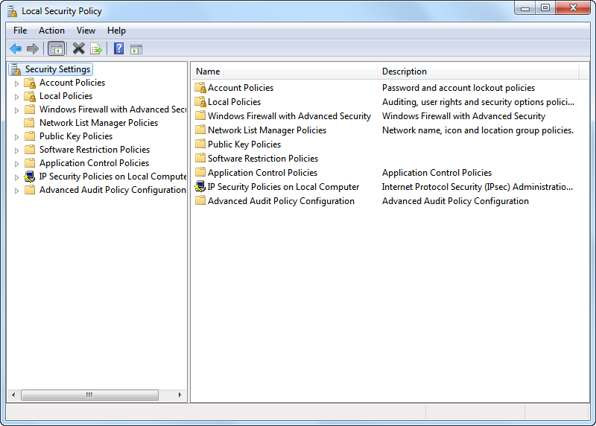
Security Procedures Windows Local Security Policy
A security policy is a set of security objectives that ensure the security of a network, the data, and the computer systems in an organization.
You can use the Windows Local Security Policy tool to implement a security policy on computers that are not part of an Active Directory domain.
Password Policy can be configured to meet a variety of requirements including password history, max age, min age, min length, and complexity.
Audit Policy can be enabled to record all logon events.
You can then export the Local Security Policy to make it easier to update another computer with the same security policy.
Notes:
12.2 - Security Procedures
12.2.1 - Windows Local Security Policy

Slide 18
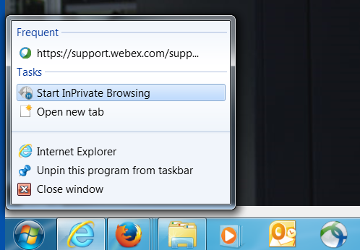
Security Procedures Securing Web Access
Browsers include various tools that can be exploited by attackers.
Most browsers have features that can be enabled to increase web security.
For example, Internet Explorer security can be enhanced by enabling:
ActiveX Filtering
Pop-up Blocker
SmartScreen Filter
InPrivate Browsing
Notes:
12.2 - Security Procedures
12.2.2 - Securing Web Access

Slide 19
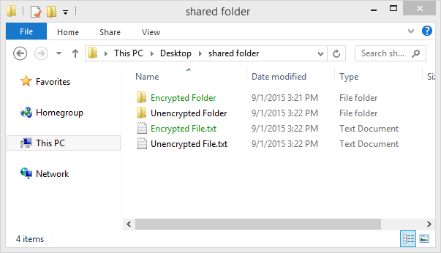
Security Procedures Protecting Data
Protecting data on computers includes a variety of techniques including:
Software, such as Windows Firewall, that filters traffic between the computer and other computers to which it is connected
Biometric, smart card, and key fob security to help prevent unauthorized physical access to the computer.
Backing up data in case of theft, loss, or damage with programs like Windows 7 Backup and Restore, or Windows 8.1 File History tools.
File and folder permissions and encryption can be used to prevent unauthorized users from viewing or modifying data.
An entire hard drive can be encrypted using Windows BitLocker.
Hard drives that need to be disposed of should be data wiped either with a software tool or a degaussing device.
When data is wiped, the hard drive can be either recycled or destroyed.
Notes:
12.2 - Security Procedures
12.2.3 - Protecting Data

Slide 20
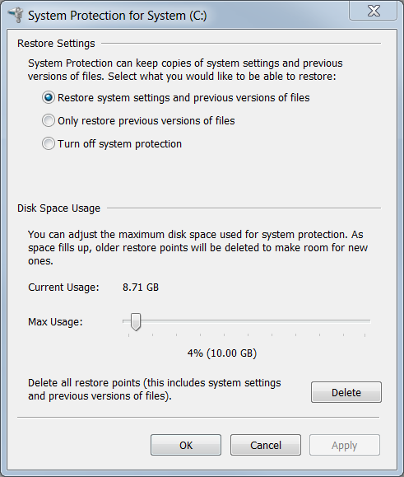
Security Procedures Protection Against Malicious Software
Antimalware programs, such as those offered by McAffee, Symantec, and Kaspersky, include antivirus protection, adware protection, phishing protection, and spyware protection.
Always retrieve the signature files from the manufacturer’s website to make sure the update is authentic and not corrupted by viruses.
If a computer becomes infected, follow these steps:
Remove the infected computer from the network.
Follow the incident response policy, which may inlcude:
Notify IT personnel
Save log file to removable media
Turn off computer
Home users should update all antimalware programs.
Boot the computer with a scan disk. This may include booting in Safe Mode.
After the computer is clean, delete system restore files to protect against reinfection.
Notes:
12.2 - Security Procedures
12.2.4 - Protection Against Malicious Software

Slide 21
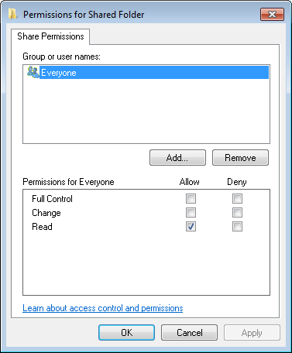
Security Procedures Security Techniques
All Windows computers on a network must be part of either a domain or a workgroup.
Before computers can share resources, they must share the same domain name or workgroup name.
Mapping a local drive is a useful way to access a single file, specific folders, or an entire drive between different operating systems over a network.
Determine which resources will be shared over the network and the type of permissions users will have to the resources.
Read - user can view data in files and run programs
Change - user can add files and subfolders, change the data in files, and delete subfolders and files
Full Control - user can change permissions of files and folders
Notes:
12.2 - Security Procedures
12.2.5 - Security Techniques

Slide 22
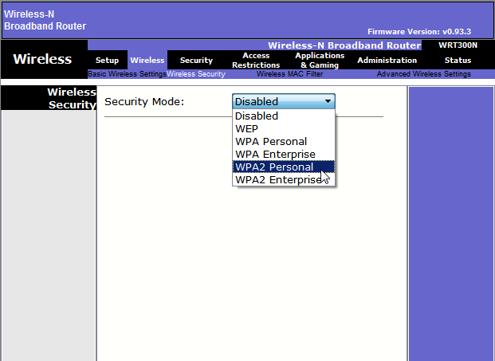
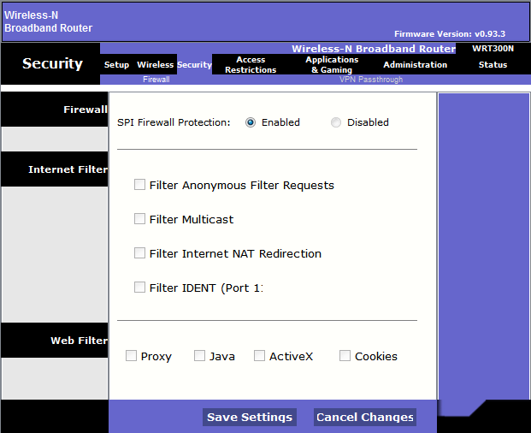
Security Procedures Security Techniques
Common security techniques include:
Encrypted communications between two computers should occur over an encrypted channel, such as those provided by virtual private networks (VPNs).
The service set identifier (SSID) broadcasting on wireless networks (WLANs) can be disabled, although this does not provide sufficient security.
Secure WLANs with the strongest security mode, which is currently WPA2.
Universal Plug and Play (UPnP), which enables devices to add themselves to the network, should be disabled. UPnP is not secure.
Be sure the firmware is up-to-date with the latest security patches.
Install and configure a firewall. Most wireless routers today include a stateful packet inspection firewall.
If you want others to be able to access a computer, server, or gaming console across untrusted or public networks, use port forwarding and isolate the computer in a demilitarized zone (DMZ).
Notes:
12.2 - Security Procedures
12.2.5 - Security Techniques

Slide 23

Security Procedures Protecting Physical Equipment
Common techniques for protecting physical equipment include:
Store network equipment in a locked wiring closet
Consider setting a BIOS or UEFI password
Disable AutoRun and AutoPlay
Implement multifactor authentication which includes:
Something you know (e.g. password)
Something you have (e.g. key fob)
Something you are (e.g. fingerprint)
Lock down all equipment with security cables.
Use card keys, video surveillance, and/or security guards if the cost is warranted. (e.g. data centers)
Notes:
12.2 - Security Procedures
12.2.5 - Security Techniques

Slide 24
12.3 Common Preventive Maintenance Techniques for Security
Notes:
Cisco Networking Academy Program
IT Essentials
Chapter 12: Security

Slide 25
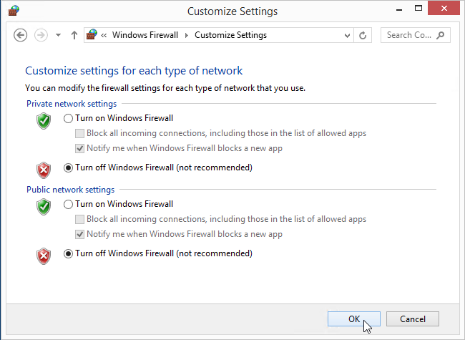
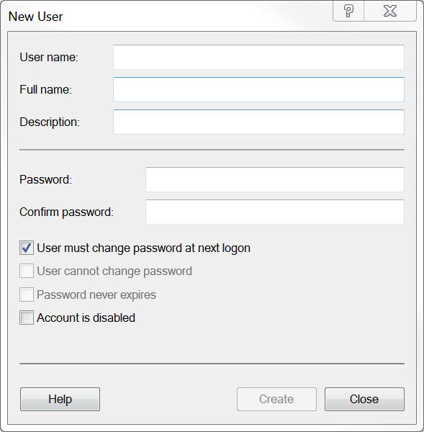
Common Preventive Maintenance Techniques for Security Security Maintenance
Maintaining security includes the following:
Keep operating systems up-to-date with security patches and service packs.
Back up data regularly.
Install, enable, and configure a software firewall, such as Windows Firewall.
Manage users including removing terminated employees, assigning temporary guest accounts, configuring login times, monitoring failed login attempts, and enforcing idle timeouts and screen locks.
In Windows, use the User Account Control or Local Users and Groups Manager to manage users.
Notes:
12.3 - Common Preventive Maintenance Techniques for Security
12.3.1 - Security Maintenance

Slide 26
12.4 Basic Troubleshooting Process for Security
Notes:
Cisco Networking Academy Program
IT Essentials
Chapter 12: Security

Slide 27
Basic Troubleshooting Process for Security Applying the Troubleshooting Process to Security
Identify the Problem
The first step in the troubleshooting process.
A list of open and closed-ended questions is useful.
Establish a Theory of Probable Cause
Based on the answers received, establish a theory probable cause.
A list of common problems can be useful.
Test the Theory to Determine Cause
Test your theories to determine the cause of the problem.
A list of quick procedures to common problems can help.
Establish a Plan of Action to Resolve the Problem and Implement the Solution
A plan of action is needed to solve the problem and implement a permanent solution.
Notes:
12.4 - Basic Troubleshooting Process for Security
12.4.1 - Applying the Troubleshooting Process to Security

Slide 28
Basic Troubleshooting Process for Security Applying the Troubleshooting Process to Security
Verify Full System Functionality and, If Applicable, Implement Preventive Measures
It is important to perform a full re-scan of the computer.
If applicable, implement preventive measures to avoid future problem recurrences, such as enabling automatic updates.
Document Findings, Actions and Outcomes
Findings, actions, and notes should be documented.
This log can be helpful for future reference.
Notes:
12.4 - Basic Troubleshooting Process for Security
12.4.1 - Applying the Troubleshooting Process to Security

Slide 29
Basic Troubleshooting Process for Security Common Problems and Solutions for Security
Security problems can be attributed to hardware, software, or connectivity issues
Common security problems include:
A user receiving thousands of junk emails daily
A rogue wireless access point is discovered on the network.
User flash drives are infecting computers.
Windows update fails.
System files have been renamed.
Notes:
12.4 - Basic Troubleshooting Process for Security
12.4.2 - Common Problems and Solutions for Security

Slide 30
12.5 Chapter Summary
Notes:
Cisco Networking Academy Program
IT Essentials
Chapter 12: Security

Slide 31
Chapter Summary Conclusion
This chapter introduced the operation of computer networks. The following concepts from this chapter are important to remember:
Malicious software (malware) is usually installed without user knowledge; capable of modifying the user’s browser; and often collects user information.
DDoS attacks use botnets located in different geographical places, making it difficult to trace.
A security policy is a set of security objectives that ensure the security of a network, the data, and the computer systems in an organization.
Most browsers have features that can be enabled to increase web security.
Protecting data on computers includes a variety of techniques including firewalls, backing up data, and file/folder permissions.
Antimalware programs, such as those offered by McAffee, Symantec, and Kaspersky, include antivirus protection, adware protection, phishing protection, and spyware protection.
All Windows computers on a network must be part of either a domain or a workgroup.
Common security techniques include VPNs, secure WLANs, disable UPnP, updated firmware, firewalls, and a DMZ.
Store network equipment in a locked wiring closet.
Maintaining security includes updating operating systems, backing up data regularly, managing firewall configurations, and managing users.
A security policy should require a systematic preventive maintenance and troubleshooting methodology.
Notes:
12.6 – Chapter Summary
12.6.1 - Conclusion

Slide 33
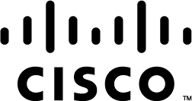

Slide 34
Chapter 12 New Terms and Commands
autoplay
autorun
biometric
bitlocker
cleartext
ddos
dmz
dns
docking
efs
exploit
grc
hacker
kaspersky
keyloggers
lenovo
mcafee
md5
mitm
msc
plaintext
pop3
rfid
rsa
secpol
sha
syn
tcp
thinkpad
trojan
upnp
wlan
worm
Notes:
New Terms and Commands

